Slide 1
50.003: Elements of Software Construction
Week 5
Basics of Threads

Slide 2
Plan for the Week
How to write multi-threaded programs to solve problems more efficiently?
Thread class: start(), join()
Runnable class
Thread class: sleep(), yield(), interrupt()

Slide 3
Multi-threaded Programming
We do have multiple processors on our laptops
We create multiple threads for parts of a job
GPU supports thousands of threads
Threads share memory
We don’t always need to send data over network (which could be un-reliable)

Slide 4


Threads
Example: evaluate$2∗K∗a∗t∗e^{−a∗t∗t}$
Core 1
start
$$2∗K$$
$$(2∗K)∗a$$
$$((2∗K)∗a)∗t$$
$$t∗t$$
$$−a∗t∗t$$
$$e^{−a∗t∗t}$$
$$e^{−a∗t∗t}$$
$${(\left(\left(2∗K\right)∗a\right)∗t \text{)}∗(e}^{−a∗t∗t})$$

Slide 5








Threads
Example: evaluate$2∗K∗a∗t∗e^{−a∗t∗t}$
Core 1
Core 2
start
$$t∗t$$
$$2∗K$$
$$−a∗t∗t$$
$$(2∗K)∗a$$
$$e^{−a∗t∗t}$$
$$((2∗K)∗a)∗t$$
$$e^{−a∗t∗t}$$
$${(\left(\left(2∗K\right)∗a\right)∗t \text{)}∗(e}^{−a∗t∗t})$$
HelloWorldThread.java

Slide 6

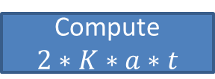
Hello World
Main Thread
Thread 1
Create thread1
Create thread2
Thread 2
start
Start thread1
Compute $2∗K∗a∗t$
Start thread2
start
Compute
$$e^{−a∗t∗t}$$
end
Join thread1
Join thread2
end
read value
Print answer
read value

Slide 7
Hello World
Main Thread
Thread 1
Create thread1
Create thread2
Thread 2
start
Start thread1
Compute $2∗K∗a∗t$
Start thread2
start
Compute
$$e^{−a∗t∗t}$$
end
Join thread1
Join thread2
end
read value
Print answer
read value

Slide 8
Hello World
Main Thread
Thread 1
Create thread1
Create thread2
Thread 2
start
Start thread1
Compute $2∗K∗a∗t$
Start thread2
start
Compute
$$e^{−a∗t∗t}$$
end
Join thread1
Join thread2
end
read value
Print answer
read value

Slide 9
Hello World
Main Thread
Thread 1
Create thread1
Create thread2
Thread 2
start
Start thread1
Compute $2∗K∗a∗t$
Start thread2
start
Compute
$$e^{−a∗t∗t}$$
end
Join thread1
Join thread2
end
read value
Print answer
read value

Slide 10
Hello World
Main Thread
Thread 1
Create thread1
Create thread2
Thread 2
start
Start thread1
Compute $2∗K∗a∗t$
Start thread2
start
Compute
$$e^{−a∗t∗t}$$
end
Join thread1
Join thread2
end
read value
Print answer
read value

Slide 11
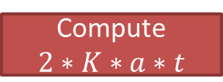
Hello World
Main Thread
Thread 1
Create thread1
Create thread2
Thread 2
start
Start thread1
Compute $2∗K∗a∗t$
Start thread2
start
Compute
$$e^{−a∗t∗t}$$
end
Join thread1
Join thread2
end
read value
Print answer
read value
Which thread moves first is non-deterministic

Slide 12

Hello World
Main Thread
Thread 1
Create thread1
Create thread2
Thread 2
start
Start thread1
Compute $2∗K∗a∗t$
Start thread2
start
Compute
$$e^{−a∗t∗t}$$
end
Join thread1
Join thread2
end
read value
Print answer
read value

Slide 13
Hello World
Main Thread
Thread 1
Create thread1
Create thread2
Thread 2
start
Start thread1
Compute $2∗K∗a∗t$
Start thread2
start
Compute
$$e^{−a∗t∗t}$$
end
Join thread1
Join thread2
end
read value
Print answer
read value

Slide 14
Hello World
Main Thread
Thread 1
Create thread1
Create thread2
Thread 2
start
Start thread1
Compute $2∗K∗a∗t$
Start thread2
start
Compute
$$e^{−a∗t∗t}$$
end
Join thread1
Join thread2
end
read value
Print answer
read value

Slide 15
Cohort Exercise 1 (15 min)
Write a program to multiply two square matrices A and B using two threads (in addition to the main thread). Hint:
public void run() {
for (int i = lower; i < upper; i++) {
for (int j = 0; j < result[i].length; j++) {
for (int k = 0; k < B.length; k++) {
result[i][j] += A[i][k]*B[k][j]; }
}
}
}
MatrixThread.java

Slide 16
Runnable interface
“implements Runnable” vs. “extends Thread”
Use Runnable that you can inherit other classes
Runnable allows better separation of the actual computation and thread control.
RunnableExample.java

Slide 17
Cohort Exercise 2 (5 min)
Continue with cohort exercise 2, refactor your matrix multiplication programs to be based on Runnable.
MatrixRunnable.java

Slide 18
Array of Threads
ThreadArrayExample.java

Slide 19
Cohort Exercise 3 (10 min)
Modify your matrix multiplication program in cohort exercise 2 so that it uses 1, 2, 3, 4, 5, 6, 7, 8, 9, 10 threads and measure the performance with a square matrix with 1,2,…,1000 rows.
MatrixThreadArray.java

Slide 20
Controlling Threads
Week 5

Slide 21
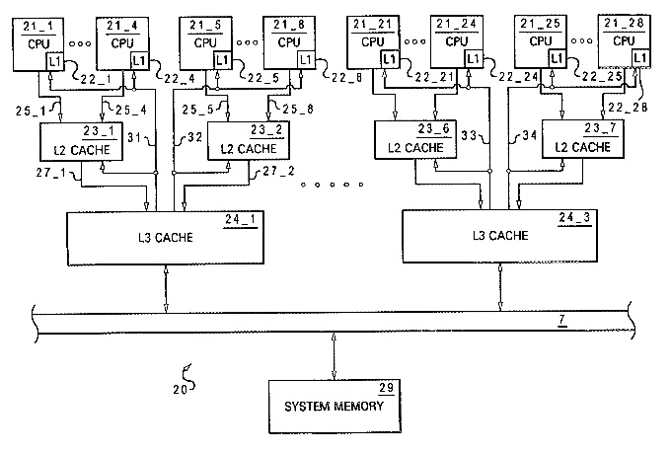
Scheduling
threads
Thread1
Thread2
Thread3
Thread4
Scheduler
The scheduler is ‘un-predictable’

Slide 22
Scheduling/Interleaving
00
thread1
thread2
0
0
01
10
1
1
02
11
20
2
2
03
12
21
30
3
3
13
22
31
23
32
33
There are exponentially many sequences.

Slide 23
Thread Control
Method | Remarks
start() | Causes this thread to begin execution; the Java Virtual Machine calls the run method of this thread.
Thread.yield() | A hint to the scheduler that the current thread is willing to yield its current use of a processor.
Thread.sleep(long millis) | Causes the currently executing thread to sleep (temporarily cease execution) for the specified number of milliseconds, subject to the precision and accuracy of system timers and schedulers.
wait() | Causes the current thread to wait until another thread invokes the notify() method or the notifyAll() method for this object.
notify() | Wakes up a single thread that is waiting on this object's monitor.
notifyAll() | Wakes up all threads that are waiting on this object's monitor.
join() | Waits for this thread to die.
interrupt() | Interrupts this thread.

Slide 24
A Thread’s Life
Thread.yield()
Thread.sleep()
start()
wait()
New Thread
Not Runnable
Runnable
notify()
run() method finishes
Terminated
We will talk about how to abort a thread later on.

Slide 25
sleep()
Coordinating threads through time
Example: Write a program with two threads, one printing 1,2,3,5 and the other printing 4 repeatedly such that the print out is
1,2,3,4,5
1,2,3,4,5
1,2,3,4,5
…
SleepExample.java

Slide 26
Expected Behavior
LeftThread
RightThread
time
print 1,2,3
sleeping
5
sleeping
print 4
10
print 5,1,2,3
sleeping
15
sleeping
print 4
20
print 5,1,2,3
sleeping
25
sleeping
print 4
30
print 5,1,2,3
sleeping
This would work except it doesn’t

Slide 27
Cohort Exercise 4 (5 min)
Take the sample program and modify the parameter for sleep() and the number of iterations and see if the ordering is preserved always.
Replace sleep() with yield() and try again.
Thread.yield() can be ignored completely

Slide 28
Thread Control
Method | Remarks
start() | Causes this thread to begin execution; the Java Virtual Machine calls the run method of this thread.
Thread.yield() | A hint to the scheduler that the current thread is willing to yield its current use of a processor.
Thread.sleep(long millis) | Causes the currently executing thread to sleep (temporarily cease execution) for the specified number of milliseconds, subject to the precision and accuracy of system timers and schedulers.
wait() | Causes the current thread to wait until another thread invokes the notify() method or the notifyAll() method for this object.
notify() | Wakes up a single thread that is waiting on this object's monitor.
notifyAll() | Wakes up all threads that are waiting on this object's monitor.
join() | Waits for this thread to die.
interrupt() | Interrupts this thread.

Slide 29
Stopping a Thread
User-requested cancellation
Time-limited activities
Application events
e.g., multiple threads are searching for an element in an array, all threads can be stopped as soon as one finds it.
Errors
Shutdown
There is no safe way to preemptively stop a thread in Java

Slide 30
How to Stop a Thread
No
destroy()
or stop()
or stop(Throwable obj)
or suspend()
Yes
Interrupt()

Slide 31
interrupt()
Example 1: interrupt() results in Exception
Example 2: handle interrupt() explicitly in run() by checking Thread.interrupted()
InterruptExample1.java and InterruptExample2.java

Slide 32
Cohort Exercise 5 (15 min)
Write a program to search for an element is in an integer array using two threads.
Hint: You can use a static variable to allow communication between searching threads and the main thread; and use interrupt() to stop a thread when the element is found.
MultiThreadSearch.java
Busy waiting is not efficient

Slide 33
Cohort Exercise 6 (20 min)
Write a multi-threaded program to factor semi-prime. Stop all threads as soon as the problem is solved.
FactorThread.java

Slide 34
Cohort Exercise (10 min)
Write a program such that N threads concurrently increment a static variable (initially 0) by 1. Set N to be 100, 1000, 10000 and see what is the value of the variable after all threads are done.

Slide 35
Is This Real?
Thread1
Thread2
0
0
00
count = 0
count++
count++
➔
count = 1
01
10
count = 1
1
1
11
count = 2
This is assuming that count++ is one step. Or is it?

Slide 36
Reality is Messy
Java Programs
Bytecode
What are the atomic steps?
JVM
What are the order of execution?
Physical Machine
What and where are the variable values?

Slide 37
What Really Happened?
Thread1
Thread2
0
0
read value of Count and assign it to a register
read value of Count and assign it to a register
1
1
Increment the register
Increment the register
2
2
Write the register value back to Count
Write the register value back to Count
3
3
For double type, even read/write is not atomic!

Slide 38
What Really Happened?
Thread1
Thread2
00
r2
r1
0
0
01
10
r1
r2
i2
i1
1
1
02
11
20
w2
w1
i1
i2
03
12
21
30
2
2
r1
r2
w1
w2
13
22
31
3
3
i1
i2
23
32
w1
w2
33

Slide 39
What Really Happened?
Thread1
Thread2
00
r2
0
0
01
10
r1
r2
r1
1
1
02
11
20
i2
i1
i2
03
12
21
30
2
2
i1
w1
w2
13
22
31
w1
3
3
23
32
w2
count=1
33
Is this correct?

Slide 40
How do we prevent such scenarios then?

